Slide 1
Agriculture Policy & Legislature
February 20, 2023
Linda Andrews
Jay Boyette

Slide 2
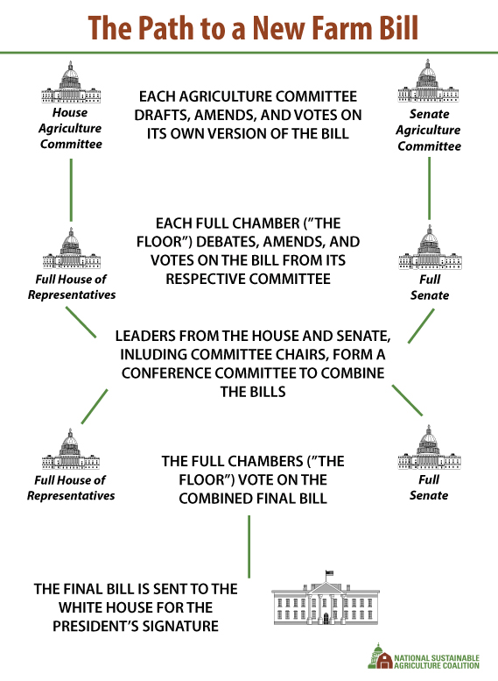

Slide 3
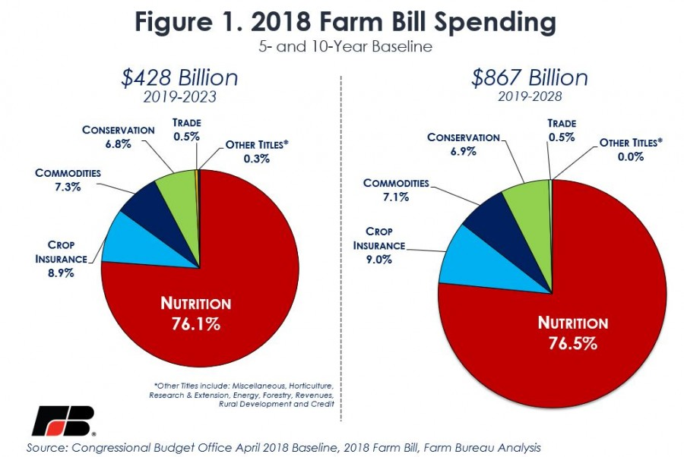
Farm Bill Spending

Slide 4
Questions?

