Slide 1
U.S. Agriculture Situation and Outlook
Blake Brown, PhD
Hugh C Kiger Professor
NC State University

Slide 2
Input Costs:
What about 2023?

Slide 3
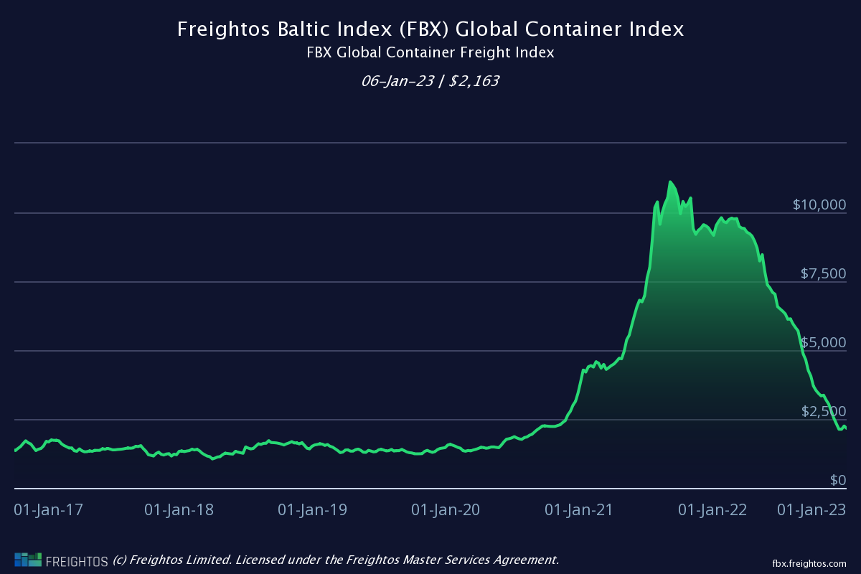

Slide 4
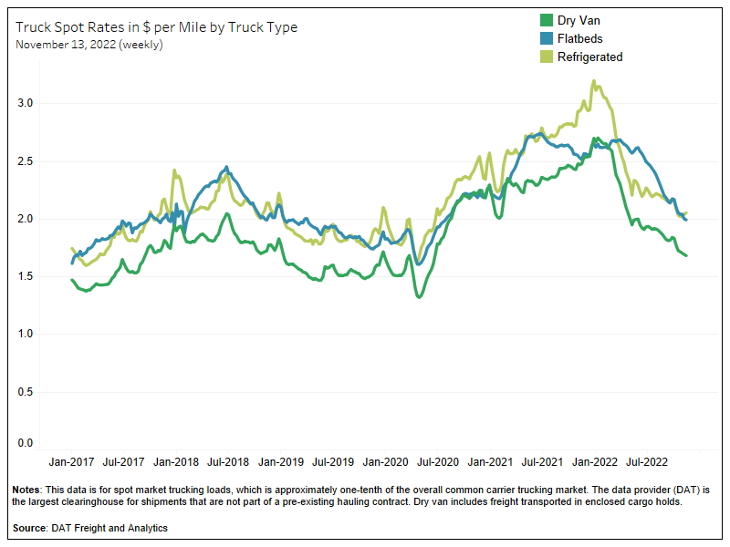

Slide 5
Fertilizer

Slide 6
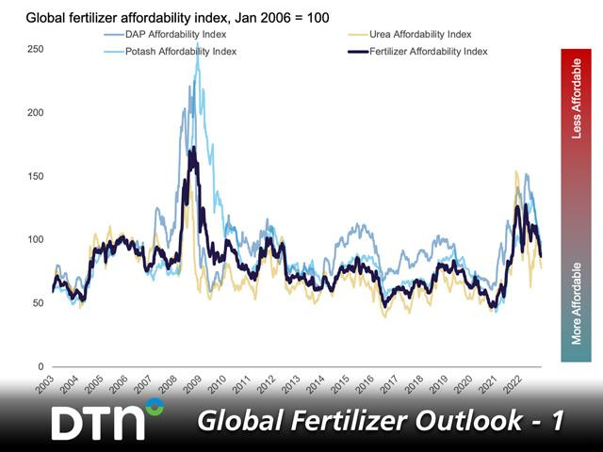

Slide 7
DTN Retail Fertilizer Trends
“Retail Fertilizer Prices Fall to Lowest Level in 15 Months”
1/25/2023 | 9:56 AM CST

Slide 8
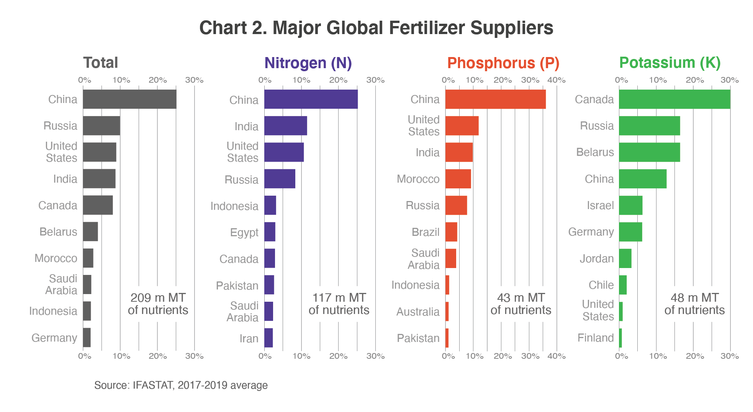

Slide 9






Potential balance of nitrogen, phosphorus and potassium in 2022 by region (1000 metric tons)
Source: FAO. 2019. World fertilizer trends and outlook to 2022. Rome.

Slide 10
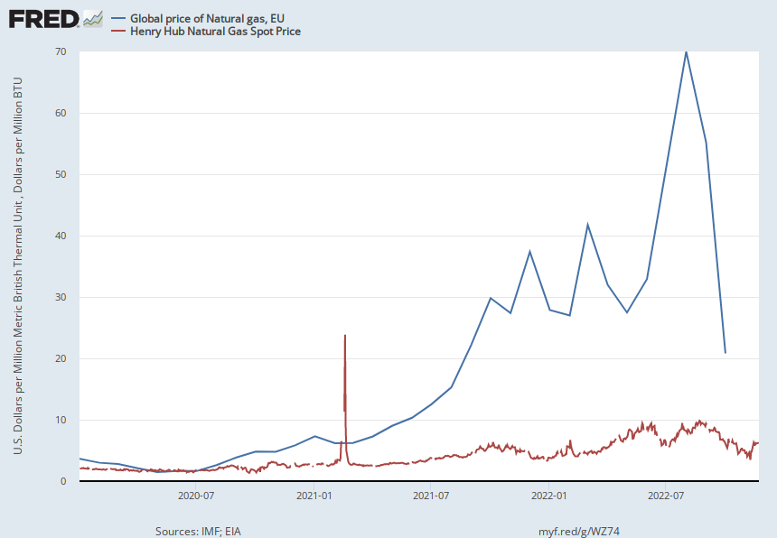
“Natural-Gas Prices Continue Free Fall” WSJ Jan 3, 2023
Notes:
Source:
International Monetary Fund
Release:
Primary Commodity Prices
Units:
U.S. Dollars per Million Metric British Thermal Unit, Not Seasonally Adjusted
Frequency:
Monthly
Value represents the benchmark prices which are representative of the global market. They are determined by the largest exporter of a given commodity. Prices are period averages in nominal U.S. dollars.Copyright © 2016, International Monetary Fund. Reprinted with permission. Complete terms of use and contact details are available at http://www.imf.org/external/terms.htm.
International Monetary Fund,
Global price of Natural gas, EU [PNGASEUUSDM],
retrieved from FRED,
Federal Reserve Bank of St. Louis;
https://fred.stlouisfed.org/series/PNGASEUUSDM,
November 29, 2022.
Source:
U.S. Energy Information Administration
Release:
Natural Gas Spot and Futures Prices (NYMEX)
Units:
Dollars per Million BTU, Not Seasonally Adjusted
Frequency:
Daily
More information about this series can be found at http://www.eia.gov/dnav/ng/TblDefs/ng_pri_fut_tbldef2.asp
U.S. Energy Information Administration,
Henry Hub Natural Gas Spot Price [DHHNGSP],
retrieved from FRED,
Federal Reserve Bank of St. Louis;
https://fred.stlouisfed.org/series/DHHNGSP,
November 29, 2022.

Slide 11
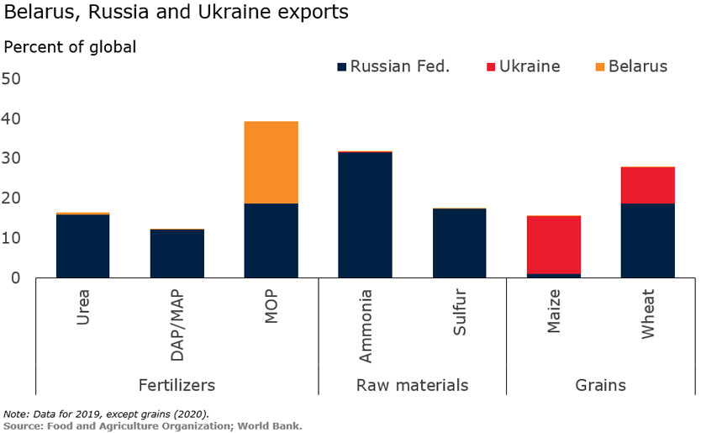


Slide 12
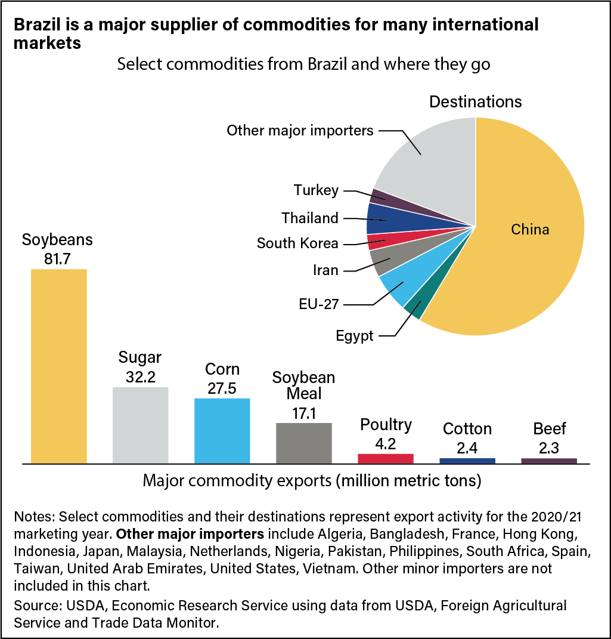

Slide 13
“Good News for Food, Bad News for War: Brazil Buys Russian Fertilizer”
New York Times May 8, 2022

Slide 14
Trade

Slide 15
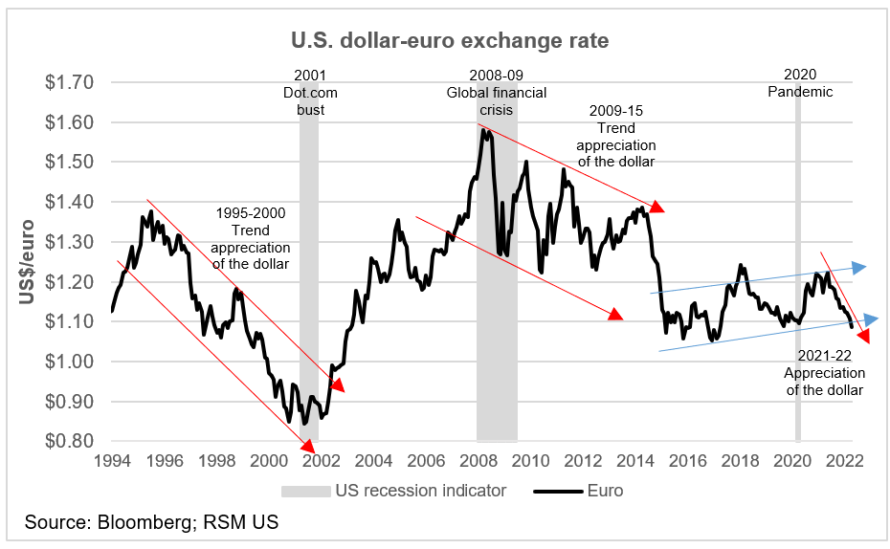

Slide 16
China Policy
US-China relations will remain strained
- “China Is National Security Threat No. 1
Resisting Beijing’s attempt to reshape and dominate the world is the challenge of our generation. “ Opinion WSJ 12-3-20 John Ratcliffe, Former Director of National Intelligence
  “Biden’s National Security Council Sharpens Focus on China” Foreign Policy 2-18-21
Will US remove tariffs on China imports?
  “Biden administration to maintain China tariffs while review continues” Reuters 9-2-22

Slide 17
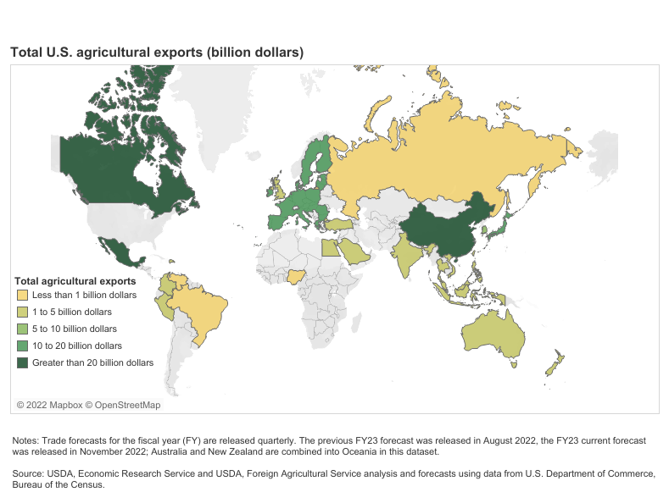

Slide 18
The 2023 Farm Bill:
Republicans control the House: traditional farm bill
Administration: climate change oriented farm bill

Slide 19
Labor

Slide 20
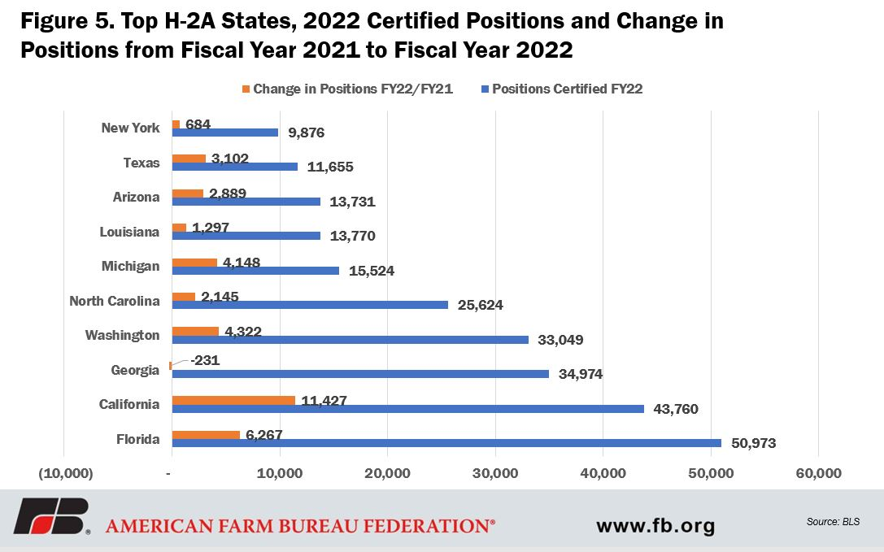
20212AEWR 2023 AEWR
NC: $14.16 NC: $14.91

Slide 21
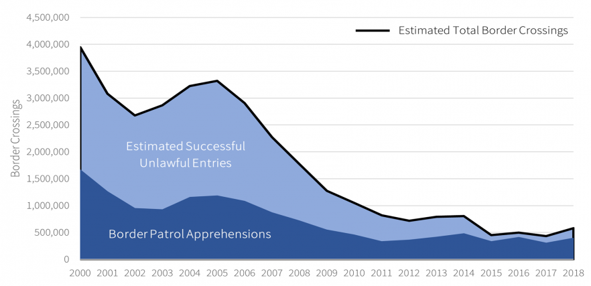
Border Crossings from Mexico
Source: “Rising Border Encounters in 2021: An Overview and Analysis” American Immigration Council | July 2021

Slide 22
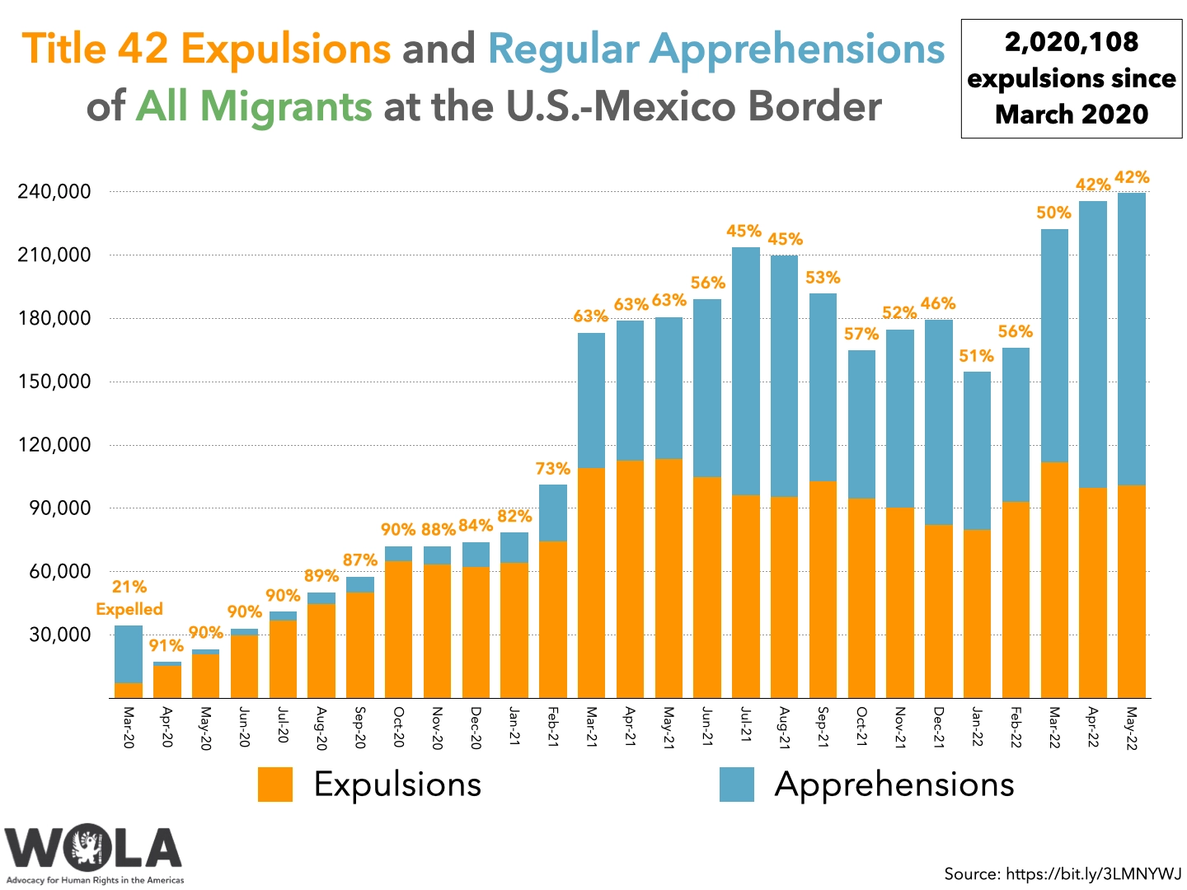

Slide 23
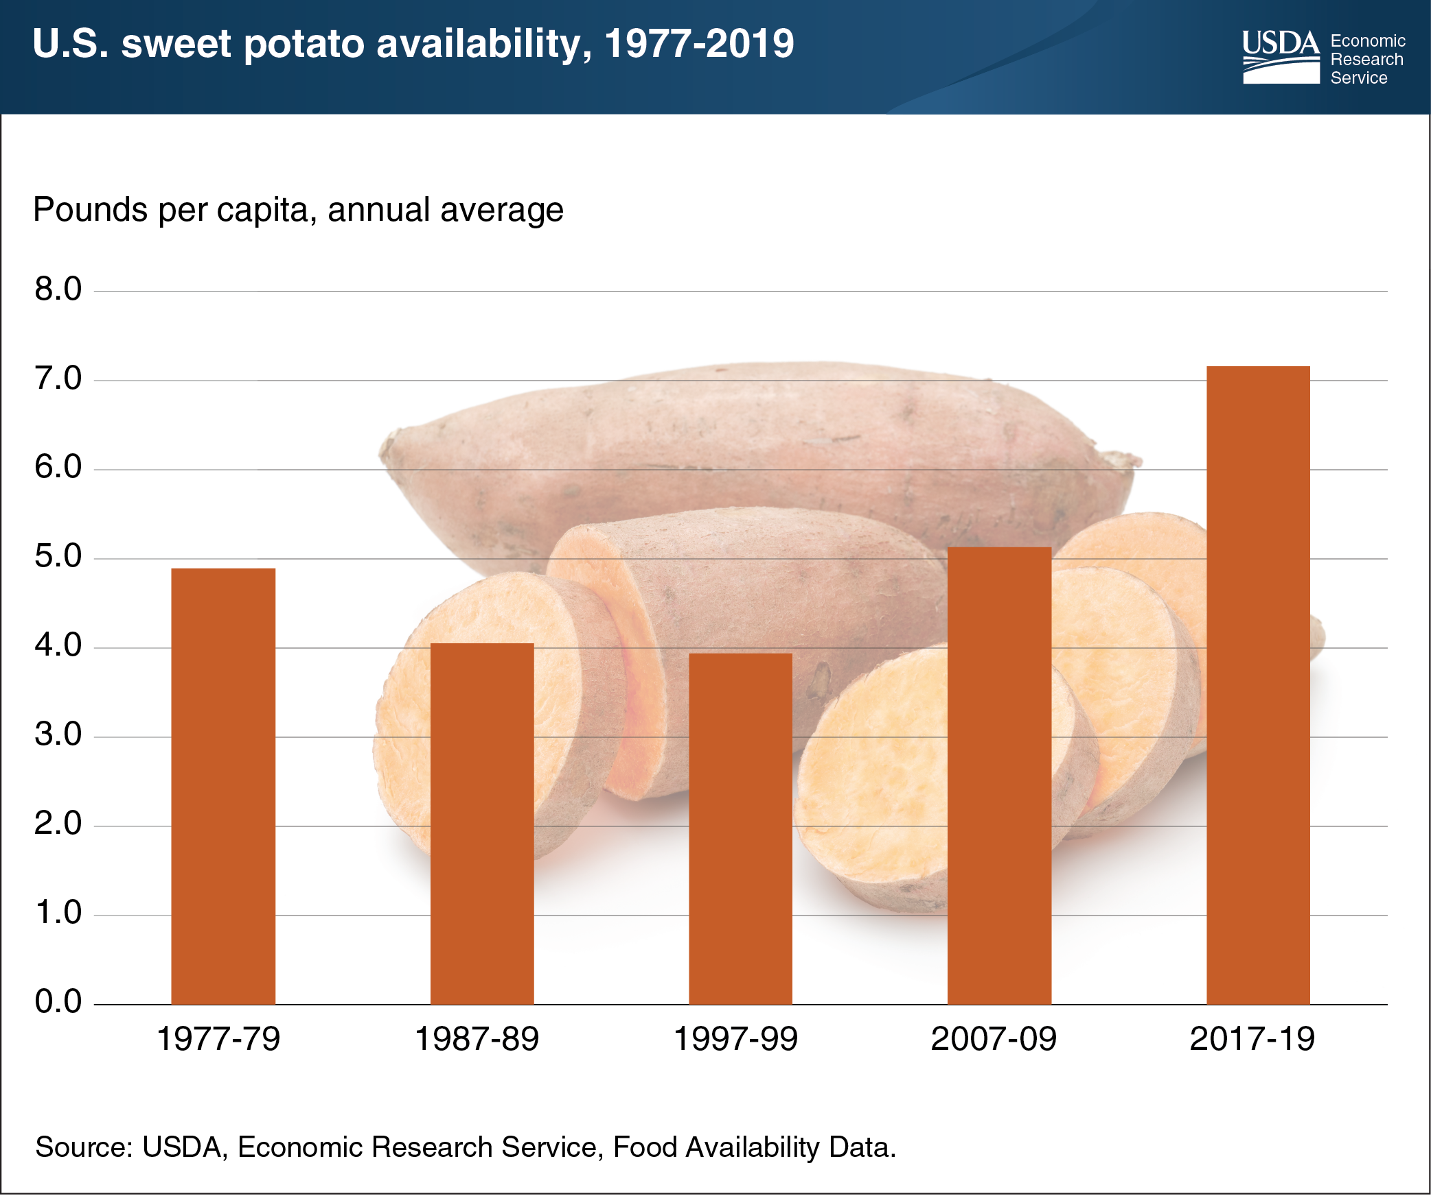

Slide 24
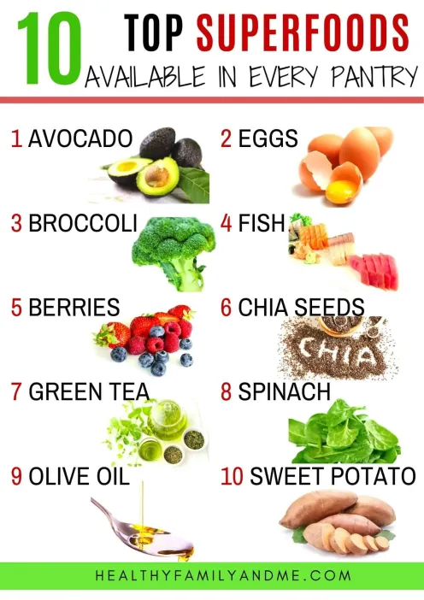
Sweetpotatoes

Slide 25
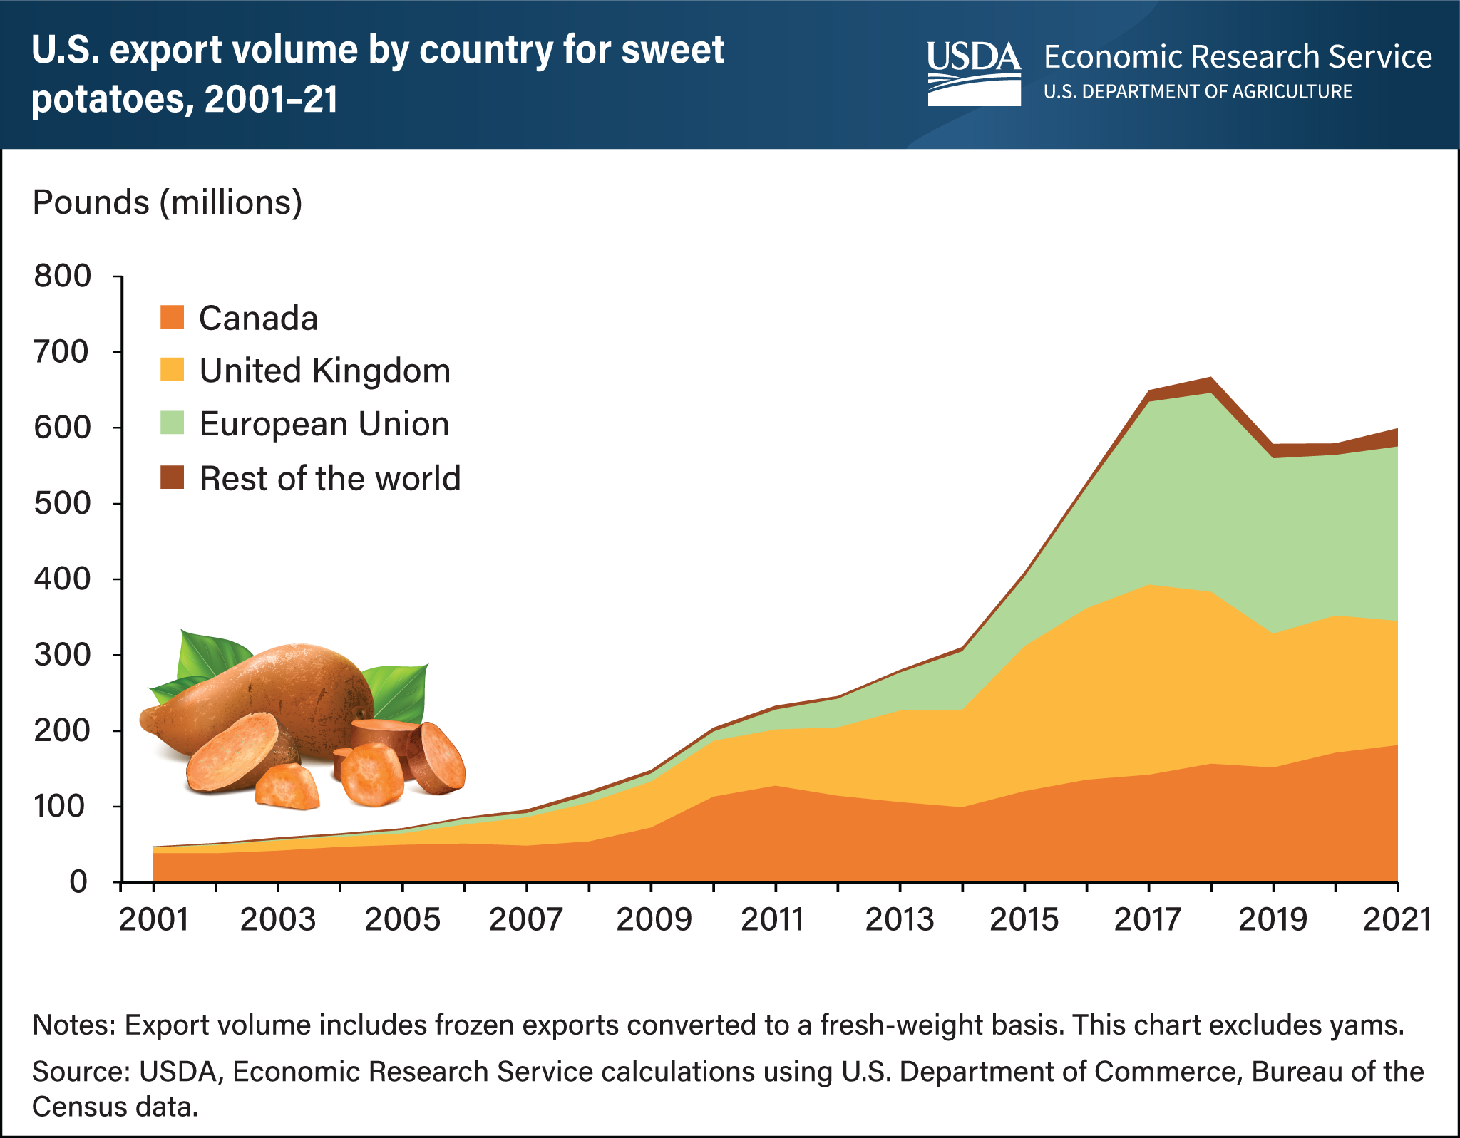

Slide 26
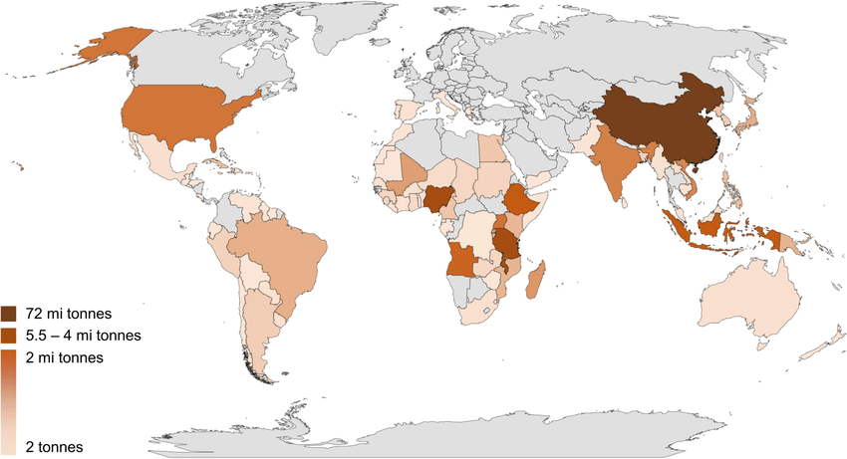


Global Sweetpotato Production

Slide 27
Cultured Meat
Lab Grown Meat
“We shall escape the absurdity of growing a whole chicken in order to eat the breast or wing, by growing these parts separately under a suitable medium.”
Winston Churchill, 1931

Slide 28
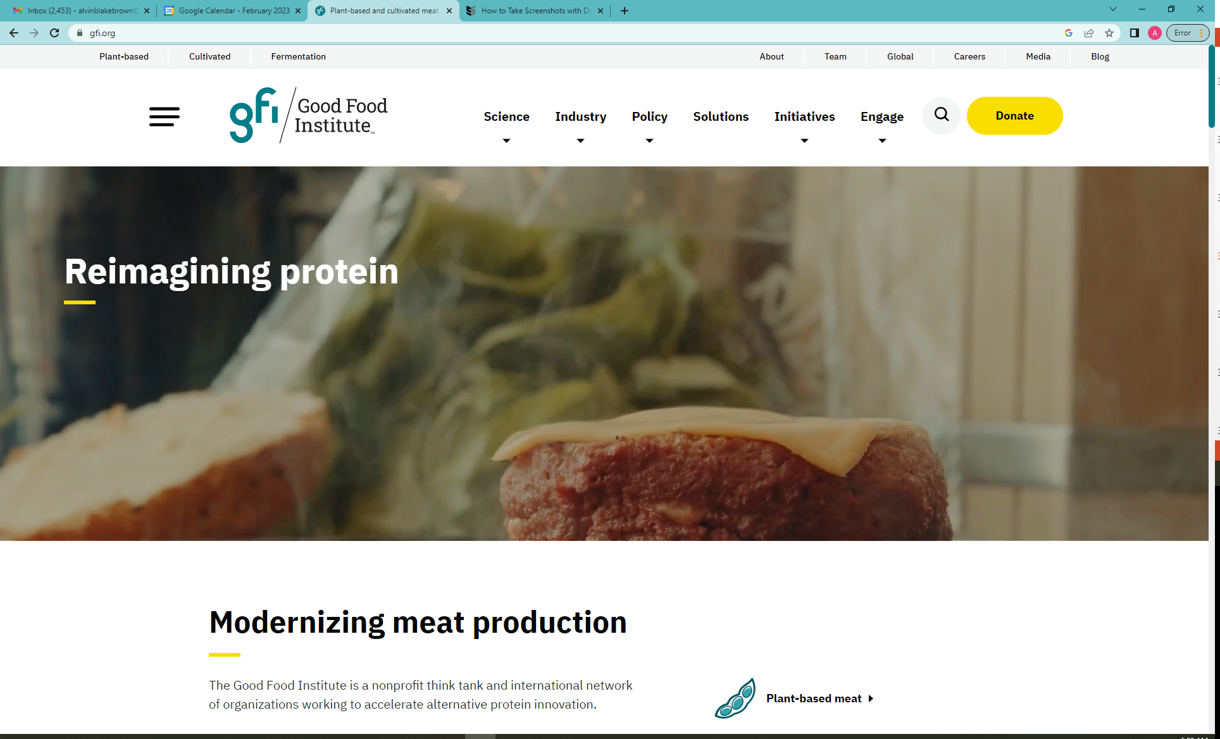

Slide 29
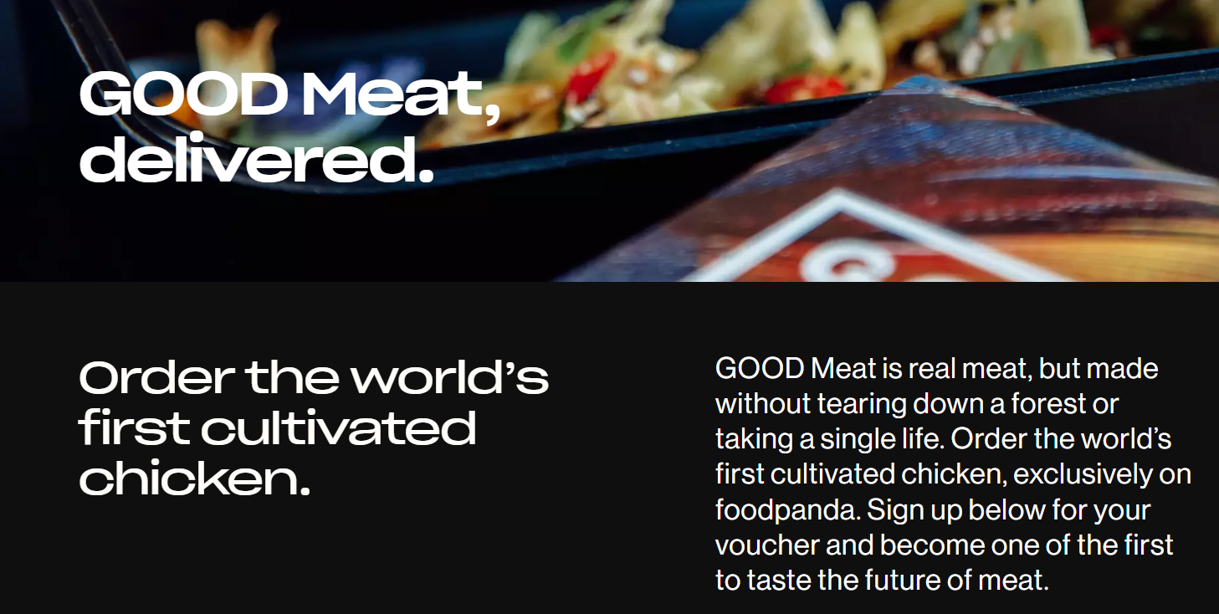
Lab-Grown Poultry Clears First Hurdle at FDA
Cultivated chicken from Upside Foods moves closer to grocery store shelves
WSJ Nov 16, 2022

Slide 30
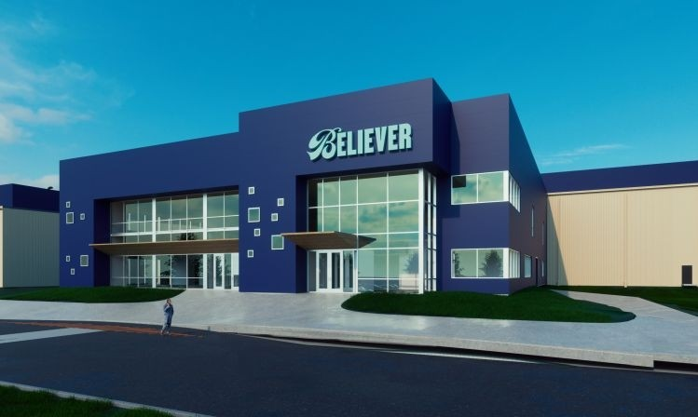
“BELIEVER Meats Breaks Ground on Largest Cultivated Meat Production Facility in The World.” CISION PR Newswire 12-7-2022

Slide 31
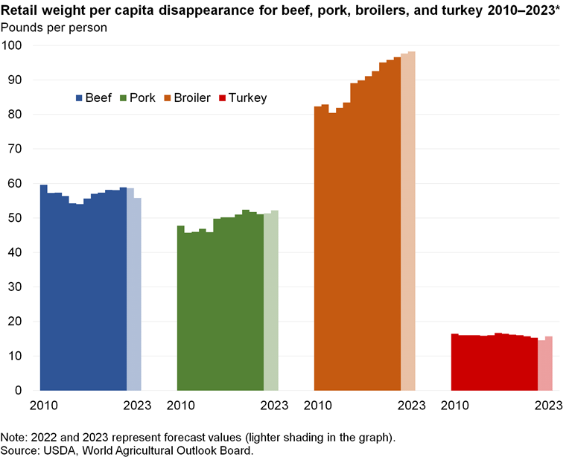

Slide 32
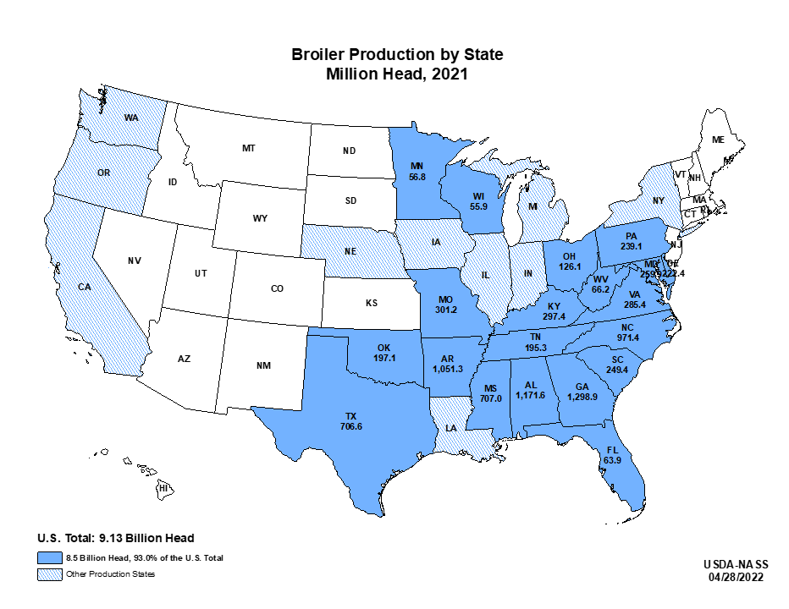

Slide 33
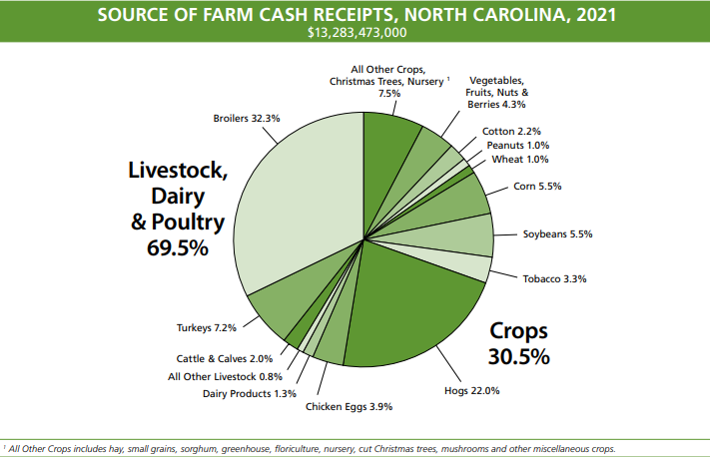
Poultry and Eggs: $5.7 Billion

Slide 34
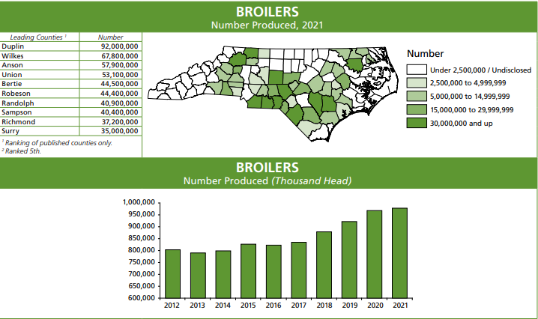

Slide 35
What “boxes” does cultured meat check
(or not)?
Reduces animal welfare concerns
More feed efficient
Reduces waste management issues
No need for thousands of contracts with Farmers
? Lower cost of production
? More environmentally friendly
? Is it safe?
? Consumer Acceptance
- concerns with Food Safety
- “frankenmeat”
- taste
- price

Slide 36
What do you “feed” cultured meat?
“… the cells are fed an oxygen-rich cell culture medium made up of basic nutrients such as amino acids, glucose, vitamins, and inorganic salts, and supplemented with proteins and other growth factors.” GFI
“…the cell culture medium, is the most important factor in cell culture technology.” GFI
“It is a more efficient way of converting crops into meat, and therefore much less land is needed to produce these crops.” Peter Sinke, CE Delft BBC Science Focus, 6-9-2022

Slide 37
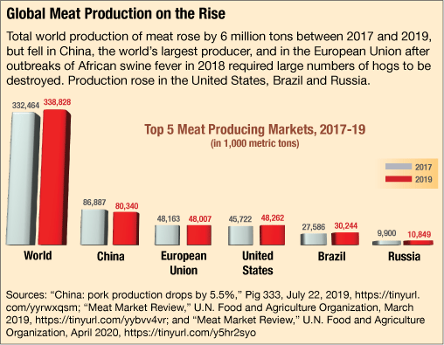

Slide 38
A paradigm shift for the meat industry?

Slide 39
Take-Aways
Pandemic related supply issues are getting better
  Lower shipping and trucking costs
Phosphate & Potash cost should decline…some
Nitrogen costs may remain high…but there is some hope. European plants may produce N again
Interest rates…high
Trade: unfavorable exchange rates BUT this could improve as Fed slows interest rate increases
Exports to China volatile and subject to political climate between US and China
Labor: 2023 AEWR $14.91

Slide 40
Take-Aways
Sweetpotatoes:
  reduced production should improve prices
  export decline difficult to overcome
  BUT continued growth in US consumption

Slide 41
Take Aways: Cultured Meat
Consumer Acceptance:
  Food safety
  Taste
  Cost
Biggest issue may be perceptions about Food Safety
It checks lots of boxes for livestock/poultry integrators
If successful….paradigm shift for the poultry industry; dramatic effects across the south, especially North Carolina
If these issues are conquered what is the time horizon?
  10, 20 years for a complete shift away from farm production in poultry; what about hogs, cattle?

