Slide 1
Now what about Crop Insurance?
Executive Farm Management
February 7, 2020
Dr. Nathan B. Smith
Extension Professor & Economist
Agribusiness Team Program Director

Slide 2
What is Crop Insurance?
A insurance policy bought by farmers to insure against multiple perils of nature.
Available for most major crops.
Works like other property and casualty insurance except it is administered and underwritten by the federal government, meaning:
The Federal Crop Insurance Act authorizes the federal crop insurance program.

Slide 3
Types of Multi Peril Crop Insurance
Federal Crop Insurance
  Common Crop Insurance Policy
    Yield
    Revenue
  Area Risk Protection (formerly Group Risk)
    Yield
    Revenue
  Whole-Farm Revenue Protection (formerly Adjusted Gross Revenue)
  Actual Production History (APH)
  Dollar Plan
  Pasture, Rangeland, Forage
    Rainfall
    Vegetation
  Stacked Income Protection for Cotton (STAX)
  Supplemental Coverage Option (SCO)
Notes:
There are basically four different kinds of crop insurance available to today’s producers.
Named Peril policies protect against a specific peril as named in the policy. A common example is crop-hail, which guards against primarily hail. Other examples would be a policy that provides frost/freeze protection below a stated temperature, or a policy that insures against rain on a specialty crop at a critical time in its development.
Group Coverage policies insure against widespread loss of production of a crop in a county. The basis behind this type of policy is that when an entire county’s crop yield is low, most producers in that county would also have low yields. National Agricultural Statistical Service (NASS) county data is used to set the expected and actual county yields. The insured chooses a percent of the expected county yield, and if the actual county yield falls below that amount, a loss is triggered. Because the policies are based on a county and not an individual yield, the insured may have a low yield and not receive a payment, or the insured may have a normal yield and get paid. Examples of this type of group coverage are Group Risk Protection (GRP) and Group Risk Income Protection (GRIP). GRIP uses a price component to place the emphasis on revenue.
Adjusted Gross Revenue (AGR) uses a producer’s historical IRS Schedule F tax form information and annual farm report to provide a level of guaranteed revenue for the insurance period.
Multiple Peril/Revenue coverage is the most utilized kind of insurance and will be the focus of this presentation.

Slide 4
Animal/Livestock Related Insurance Policies
Dairy Revenue Protection
Livestock Risk Protection
  Fed Cattle,
  Feeder Cattle,
  Lamb,
  Swine
Livestock Gross Margin
  Dairy,
  Cattle,
  Lamb,
  Swine
Notes:
There are basically four different kinds of crop insurance available to today’s producers.
Named Peril policies protect against a specific peril as named in the policy. A common example is crop-hail, which guards against primarily hail. Other examples would be a policy that provides frost/freeze protection below a stated temperature, or a policy that insures against rain on a specialty crop at a critical time in its development.
Group Coverage policies insure against widespread loss of production of a crop in a county. The basis behind this type of policy is that when an entire county’s crop yield is low, most producers in that county would also have low yields. National Agricultural Statistical Service (NASS) county data is used to set the expected and actual county yields. The insured chooses a percent of the expected county yield, and if the actual county yield falls below that amount, a loss is triggered. Because the policies are based on a county and not an individual yield, the insured may have a low yield and not receive a payment, or the insured may have a normal yield and get paid. Examples of this type of group coverage are Group Risk Protection (GRP) and Group Risk Income Protection (GRIP). GRIP uses a price component to place the emphasis on revenue.
Adjusted Gross Revenue (AGR) uses a producer’s historical IRS Schedule F tax form information and annual farm report to provide a level of guaranteed revenue for the insurance period.
Multiple Peril/Revenue coverage is the most utilized kind of insurance and will be the focus of this presentation.

Slide 5
Private Crop Insurance Policies
  Named Peril
    Crop Hail
    Lightning
    Fire
    Replant
    Rainfall
    Porcine Virus
    Stored Grain
    Now Hurricane?
    Others...

Slide 6
Federal Crop Insurance Versus Private Crop-Hail Insurance
 | Federal Crop Insurance | Private Crop-Hail Insurance
Regulator | Risk Management Agency (RMA) of USDA | State Departments of Insurance
Subsidized? | Yes | No
Premium Rate | Set by RMA | Set by Individual companies
Perils covered | All risk basis: Yield losses due to natural causes; Also revenue losses due to price movements and yield losses. | Named perils basis: Losses due to hail and others (fire, lightening, transit, etc)

Slide 7
MPCI Plans
MPCI
Area Risk
Protection Insurance
Common Crop Insurance Policy
Area Yield Protection (AYP)
Area Revenue Protection (ARP)
Yield Protection
Revenue Protection
(with High and Low Price)
Revenue Protection with Harvest Price Exclusion

Slide 8
What Losses Are Covered?
Adverse weather conditions i.e. drought, flood, freeze, hail, wind…
Fire
Insects
Disease
Wildlife
Earthquake
Volcanic eruption
Failure of the irrigation water supply
Notes:
As its name indicates, “multiple” peril crop insurance provides protection from a variety of naturally occurring perils. The Crop Provisions list the specific causes of loss covered for each crop insurable under the MPCI program. While some crops vary somewhat, the policy language in most Crop Provisions provide coverage against the following causes of loss which occur within the insurance period:
Adverse weather conditions;
Fire;
Insects, but not damage due to insufficient or improper application of disease control measures;
Plant disease, but not damage due to insufficient or improper application of disease control measures;
Wildlife;
Earthquake;
Volcanic eruption; or
Failure of the irrigation water supply, if applicable, due to an unavoidable cause of loss occurring within the insurance period.

Slide 9
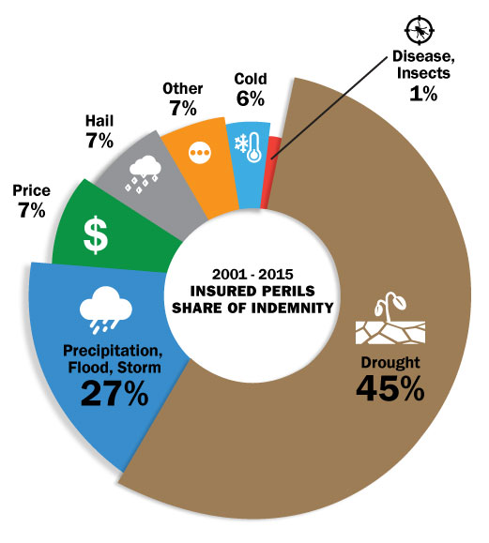
Indemnities Nationally:
Notes:
Here is a snapshot from 2001-2015 of indemnities nationally, by peril.
Drought clearly had the most shares of indemnity over that 15 year period.
2018 so far:
Drought 41%
Precipitation, and storms, about a quarter
Pretty consistent with that 15 year average

Slide 10
Why Government Involvement?
Crop Insurance has a long history.
First private policy was for wheat, ended up a major failure.
Agricultural losses were too risky for private companies to insure.
Crop losses tend to be correlated over large areas.
Market Failure - The large correlated losses prevented commercial development of policies for many years.
  Companies could not cover losses
  Producers could not afford full premiums
Solution was a government subsidized insurance program.
But…Moral Hazard and Adverse Selection were problems.
Notes:
Unlike other insured losses that tend to be independent, random events, crop losses tend to be correlated. For example, when drought strikes, it will generally impact a large geographic area.
For insurance companies, correlation of losses means that capital requirements are higher in order to maintain adequate reserves to cover widespread losses like drought. This prevented commercial development of multiple peril policies for many years. For producers, correlation of losses means premiums are unaffordable.
Insurers generally refer to a a single event that results in multiple losses as a catastrophe, such as an earthquake or hurricane. In crop insurance, catastrophic losses are the norm rather than the exception. Government involvement is necessary to make the crop insurance affordable for both the company and the producer.

Slide 11
History
Congress first authorized Federal crop insurance in the 1930s along with other initiatives to help agriculture recover from the combined effects of the Great Depression and the Dust Bowl.
The Federal Crop Insurance Corporation (FCIC) was created in 1938 to carry out the program.
  Pilot project or experimental
  Limited to few major crops in the main producing areas.
Crop insurance remained an experiment until passage of the Federal Crop Insurance Act of 1980.

Slide 12
1980 Federal Crop Insurance Act
Expanded the crop insurance program to many more crops and regions of the country.
Expanded with the idea of replacing free disaster coverage offered under Farm Bills created in the 1960s and 1970s.
  Free disaster coverage competed with the experimental crop insurance program.
The 1980 Act authorized a subsidy equal to 30 percent of the crop insurance premium limited to the dollar amount at 65-percent coverage.
Although more farmers took part in the program after passage of the 1980 Act, it did not achieve the level of participation that Congress had hoped for.
Source: RMA website

Slide 13
Major Crop Insurance Legislation Since 1980
Federal Crop Insurance Reform Act of 1994
  Made participation mandatory to receive disaster assistance.
In 1996, Congress repealed the mandatory participation requirement and created the Risk Management Agency (RMA) to administer FCIC programs and other noninsurance-related risk management and education programs.
The Agricultural Risk Protection Act (ARPA) of 2000
  Shifted research and development of new insurance products and features to private sector.
  Removed restrictions on the development of livestock insurance products.
  Increased premium subsidies.

Slide 14
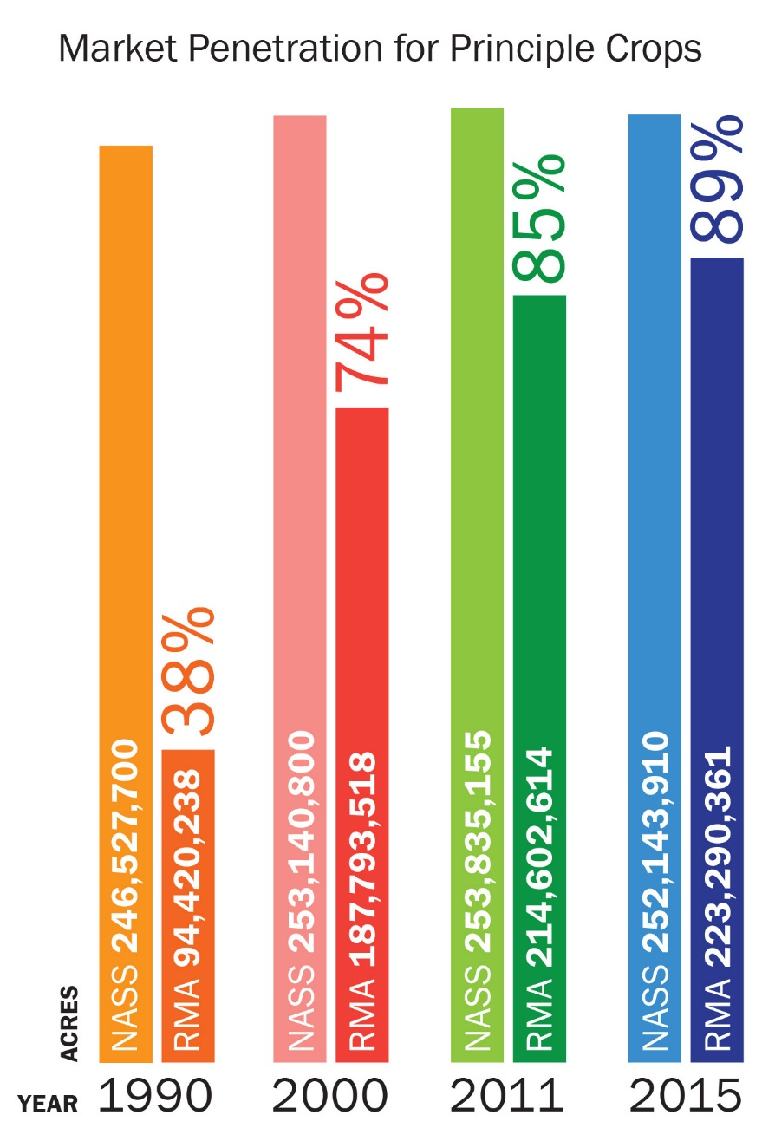
Market Penetration of Principle Crops

Slide 15
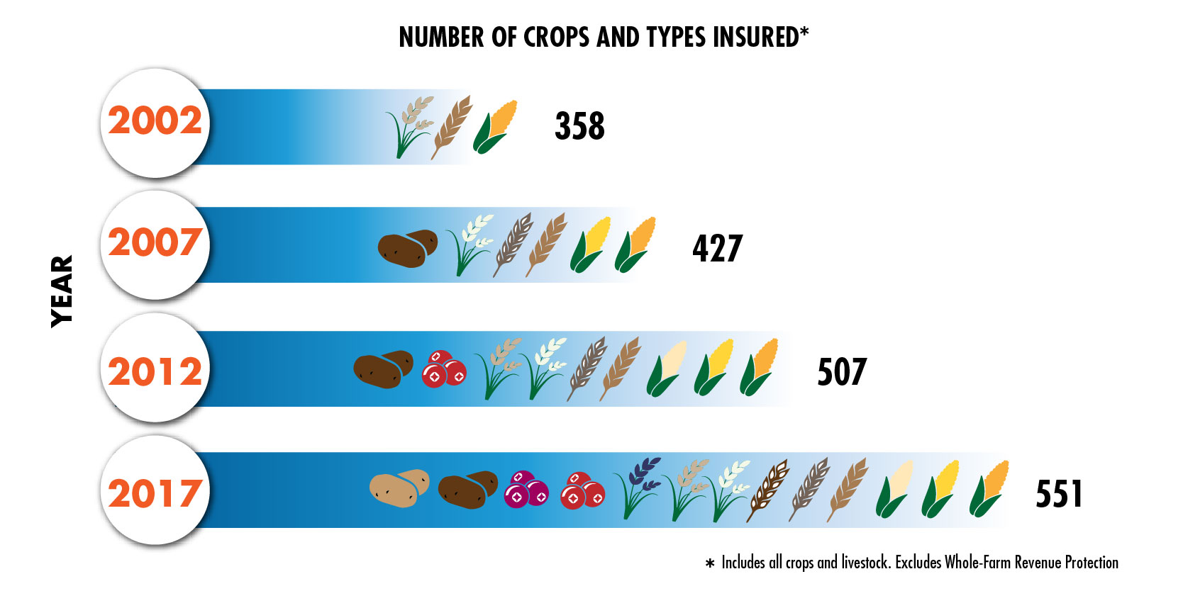
Program Expansion:
Notes:
Of course today we cover much more than corn! And we want to continue in that direction
We’ve seen plenty of growth in crops and types insured in the last 15 years as this graphic demonstrates.
When we visited Connecticut recently I spoke with Oyster producers to explore a policy.

Slide 16
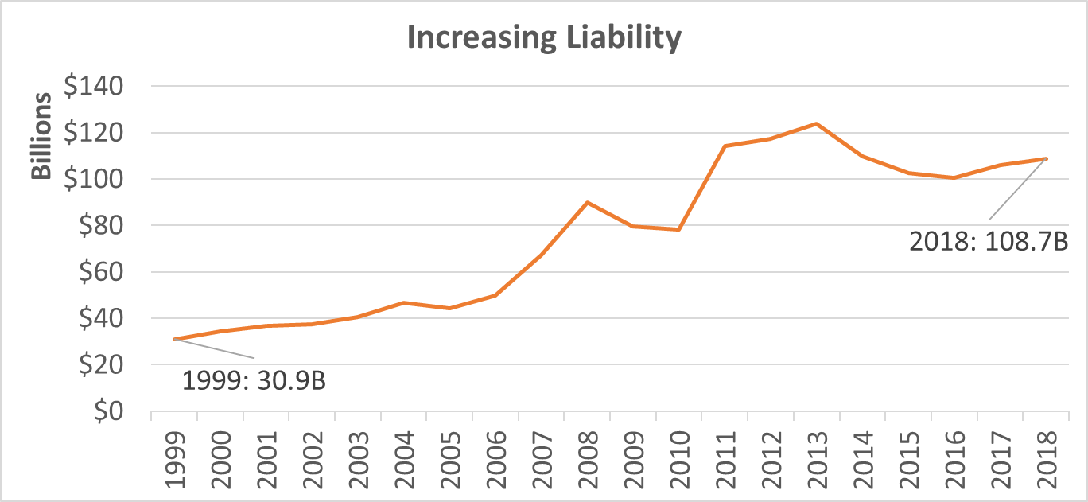
Program Growth
*Data as of September 2018 , subject to change
Notes:
Currently there is about $108.7 billion in total liabilities for Federal crop insurance
It has grown well over three fold in the past 20 years

Slide 17
Top 10 Crops by Liability
2017 Rank | Commodity | Liability (Billions) | Percent of Total
1 | Corn | $39.43 | 37.20%
2 | Soybeans | $28.41 | 26.80%
3 | Wheat | $5.89 | 5.60%
4 | Cotton | $4.95 | 4.70%
5 | WFRP | $2.86 | 2.70%
6 | Almonds | $2.58 | 2.40%
7 | PRF | $1.74 | 1.60%
8 | Grapes | $1.51 | 1.40%
9 | Apples | $1.28 | 1.20%
10 | Rice | $1.26 | 1.20%
 | All Other | $16.19 | 15.30%
 | Total | $106.1
2018 Rank | Commodity | Liability (Billions) | Percent of Total
1 | Corn | $39.88 | 36.70%
2 | Soybeans | $28.57 | 26.30%
3 | Wheat | $6.87 | 6.30%
4 | Cotton | $5.65 | 5.20%
5 | WFRP | $2.64 | 2.40%
6 | PRF | $2.38 | 2.20%
7 | Almonds | $2.13 | 2.00%
8 | Rice | $1.63 | 1.50%
9 | Grapes | $1.56 | 1.40%
10 | Nursery | $1.39 | 1.30%
 | All Other | $16.03 | 14.70%
 | Total | 108.73
*Data as of September 2018 , subject to change
Notes:
We’ll give you snapshots of the program throughout this presentation
Here’s a look at top crops by liability around the country

Slide 18
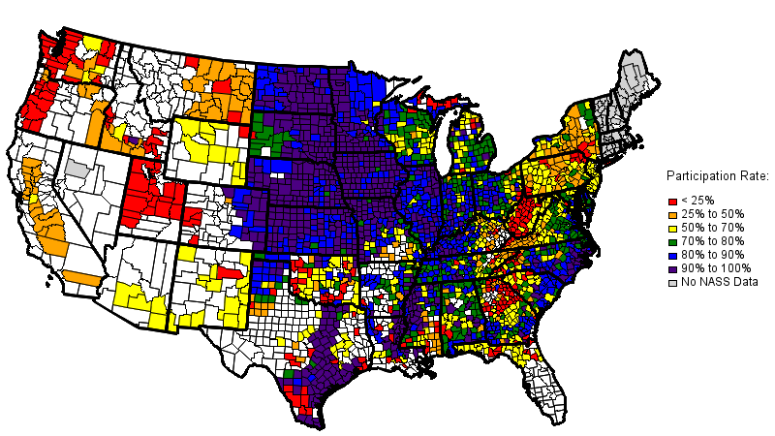
Corn Participation
2017
Overall: 86%
*Data as of September 2018, subject to change.
Notes:
Just a quick look at corn nationally
We are glad to help anyone find participation rates for any crop if you contact us

Slide 19
Part of Risk Management Legislation
Insurance is a pooled risk mitigation solution.
If people unfairly select the highest risks to insure, the insurance doesn’t work – Adverse Selection
If people change their behavior after purchase, the insurance doesn’t work – Moral Hazard
Problems of Adverse Selection and Moral Hazard have been minimized in the modern crop insurance program but still a problem.

Slide 20
Adverse Selection
A case of information asymmetry. One party in a transaction has more information than another on relative risks of what’s being insured.
Example:
  A farmer knows which fields are likely to fail if planted to certain crops or under certain conditions like too much rain or too dry. The insurer does not

Slide 21
Moral Hazard
Moral hazard occurs when, as a result of purchasing insurance, policyholders make production decisions that significantly increase the probability of loss and/or the magnitude of loss.
Fraud is an extreme example of moral hazard. But moral hazard need not imply illegal or unethical behavior. It may be simply a subtle change in farming practices as a result of having purchased insurance.
Example:
  choosing to forego an expensive pesticide treatment when it is uncertain whether the pest will pose a problem during the current growing season.

Slide 22
Reinsurance
A form of insurance for insurance companies
The objective is to remove some degree of financial uncertainty by protecting themselves against economic loss
Enables insurance companies to plan more effectively for contingencies
Notes:
There are basically four different kinds of crop insurance available to today’s producers.
Named Peril policies protect against a specific peril as named in the policy. A common example is crop-hail, which guards against primarily hail. Other examples would be a policy that provides frost/freeze protection below a stated temperature, or a policy that insures against rain on a specialty crop at a critical time in its development.
Group Coverage policies insure against widespread loss of production of a crop in a county. The basis behind this type of policy is that when an entire county’s crop yield is low, most producers in that county would also have low yields. National Agricultural Statistical Service (NASS) county data is used to set the expected and actual county yields. The insured chooses a percent of the expected county yield, and if the actual county yield falls below that amount, a loss is triggered. Because the policies are based on a county and not an individual yield, the insured may have a low yield and not receive a payment, or the insured may have a normal yield and get paid. Examples of this type of group coverage are Group Risk Protection (GRP) and Group Risk Income Protection (GRIP). GRIP uses a price component to place the emphasis on revenue.
Adjusted Gross Revenue (AGR) uses a producer’s historical IRS Schedule F tax form information and annual farm report to provide a level of guaranteed revenue for the insurance period.
Multiple Peril/Revenue coverage is the most utilized kind of insurance and will be the focus of this presentation.

Slide 23
2018 Crop Insurance Premiums by Type

Slide 24
Revenue Policies Now 77% of
Total Premium

Slide 25
Crop Insurance Loss Ratio
Loss Ratio = Total Indemnities/Total Premiums

Slide 26
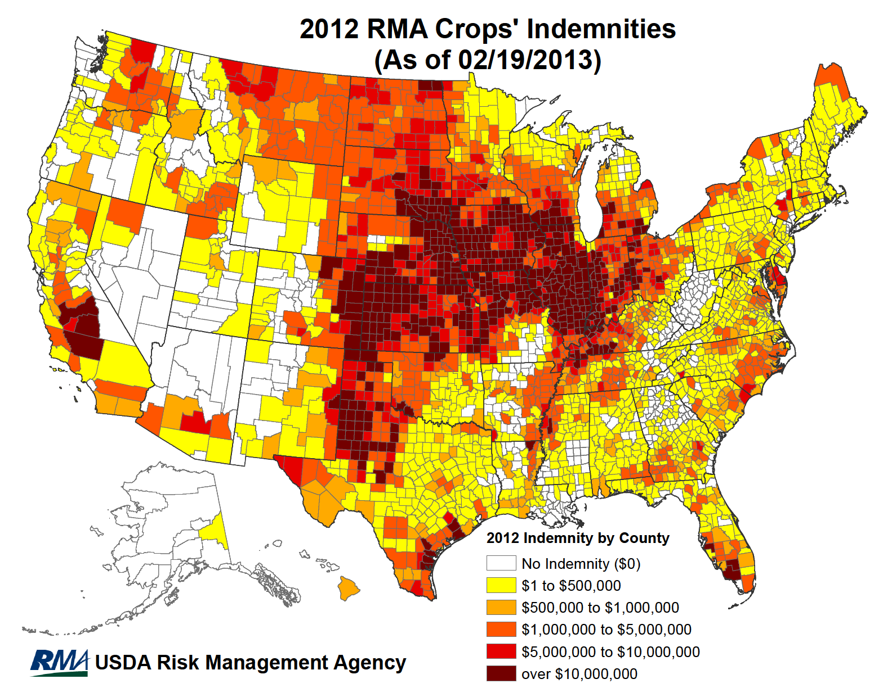

Slide 28
Basic Components of the Crop Insurance Program
Farmers
Licensed Crop Insurance Agents
(Most agents work for more than one company)
Responsible for Sales and Premium Collection of the Farmer-paid Portion
Approved Insurance Providers (AIP’s)
Responsible for Delivery of the Program
Agrees to Indemnify the Insured Farmer Against Losses
Federal Crop Insurance Corporation (FCIC)
(Managed by USDA/RMA)
Responsible for Policy Development, Rating, Reinsurance, and
Administrative Expense Support
(as negotiated and contracted by the Standard Reinsurance Agreement)

Slide 29
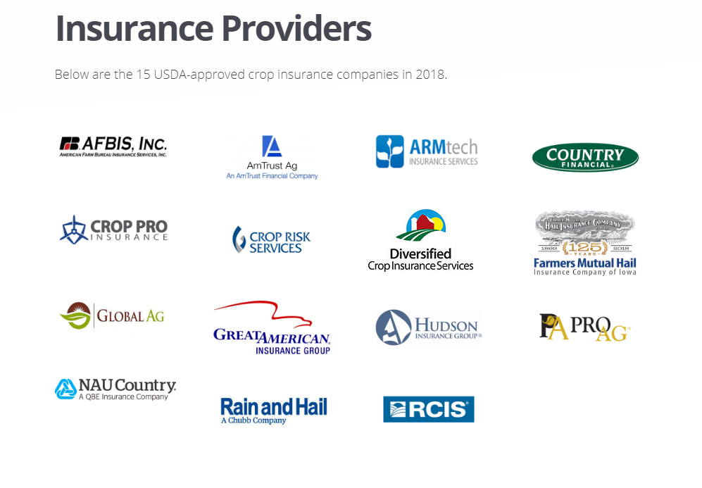

Slide 30
Overview of Policies
Yield Protection (YP)
  The fundamental crop insurance policy
  Yield guarantee based on actual yield history
  If harvested yield is less than yield guarantee, farmer receives an indemnity
  Multiple Peril Crop Insurance (MPCI)
  Catastrophic Coverage (CAT) is the minimum APH coverage anyone can buy

Slide 31
Overview of Policies
Revenue Protection (RP)
  Revenue guarantee based on actual yield history and futures markets prices at planting or actual price at harvest.
  If harvest revenue is less than revenue guarantee, farmer receives a payment.
  Essentially combines APH yield coverage with price coverage.
  Paying for a Put and Call Option on price. Generally cheaper than purchasing option in futures when prices are volatile.

Slide 32
Overview of Policies
Area Yield Protection (AYP)
  If USDA-NASS county average yield less than chosen guarantee, farmer receives indemnity
  Like APH, but for county yield
Area Revenue Protection (ARP)
  If county average revenue less than chosen guarantee, farmer receives indemnity
  Adds low price coverage to GRP
  Like RP (post CRC), but for county average yield

Slide 33
Overview of Policies
Dollar Amount of Insurance (Dollar Plans)
  RMA determines available dollar amounts of coverage and producer chooses amount.
  If stand kill/yield loss occurs, then grower receives payment.
  Like APH, but RMA, not grower yield history, determines available coverage.
  Limited availability.

Slide 34
Catastrophic (CAT) Coverage
Cheapest insurance a producer can buy:
  50% yield coverage.
  55% price election.
CAT premium completely subsidized
  Producer pays $300 $655 administrative fee per crop in each county. Max $750/County?
CAT fee can be waived for limited-resource farmers.
Insuring the bottom third of revenue…You get what you pay for

Slide 35
OTHER INSURANCE
  NAP – Non-Insured Assistance Program
    Essentially CAT coverage for non-covered crops.
    Can buy-up NAP coverage.
  The 2018 Farm Bill reinstates 50 to 65 percent of expected production in 5 percent increments, at 100 percent of the average market price.
  Producers of organics and crops marketed directly to consumers also may exercise the "buy-up" option.
Notes:
Historical review of what we now have:
-yields based upon APH and do not include many of the fruit & vegetable crops
-crop price is set by RMA and does not reflect what organic, fruit & vegetable producers receive: regular soybeans with CRC/RA base price of $6.08 per bushel for 2006 – organic food grade soybeans $12-16 per bushel
-currently, if you can get organic coverage, there is a 5% premium increase
-currently no greenhouse, cut flower, etc. coverage
-Livestock Rick Protection & Livestock Gross Margin insurances are too complicated

Slide 36
OTHER INSURANCE
  Livestock Risk Protection Insurance
    Livestock Revenue Protection (LRP)
    Livestock Gross Margin (LGM)
    Are complicated, require lots of record keeping and generally not available in the Southeast except dairy and swine.
  Whole Farm Revenue Protection may provide needed protection.
Notes:
Historical review of what we now have:
-yields based upon APH and do not include many of the fruit & vegetable crops
-crop price is set by RMA and does not reflect what organic, fruit & vegetable producers receive: regular soybeans with CRC/RA base price of $6.08 per bushel for 2006 – organic food grade soybeans $12-16 per bushel
-currently, if you can get organic coverage, there is a 5% premium increase
-currently no greenhouse, cut flower, etc. coverage
-Livestock Rick Protection & Livestock Gross Margin insurances are too complicated

Slide 37
What Level of Coverage Do I Buy?
Subsidy Factors
Selection Criteria
Year: 2020 |  |  | Commodity: Corn (0041) |  |  |  |  |  |  |  | State: South Carolina (45)
Data: Released |  |  | Plan: |  | Yield Protection (01) |  |  |  |  |  | County: Marion (067)
Subsidy Factors
Coverage Level |  |  |  |  |  |  | CAT | 0.5 |  |  |  | 0.55 | 0.6 | 0.65 | 0.7 | 0.75 |  | 0.8 | 0.8 |  | 0.85 | 0.85
Subsidy Factor |  |  |  |  |  | Basic Unit | 1 | 0.67 |  |  |  | 0.64 | 0.64 | 0.59 | 0.59 | 0.55 |  | 0.48 | 0.48 |  | 0.38 | 0.38
 |  |  |  |  |  | Optional Unit |  | 0.67 |  |  |  | 0.64 | 0.64 | 0.59 | 0.59 | 0.55 |  | 0.48 | 0.48 |  | 0.38 | 0.38
 |  |  |  |  |  | Enterprise Unit |  | 0.8 |  |  |  | 0.8 | 0.8 | 0.8 | 0.8 | 0.77 |  | 0.68 | 0.68 |  | 0.53 | 0.53
 |  |  |  |  |  | Enterprise Unit by Irrigation Practice |  | 0.8 |  |  |  | 0.8 | 0.8 | 0.8 | 0.8 | 0.77 |  | 0.68 | 0.68 |  | 0.53 | 0.53

Slide 38
Whole Farm Revenue Protection
Summary of Business
Year | Policies | Policies Indemnified | Liability | Total Premium | Subsidy | Indemnity | Loss Ratio
2012* | 802 | 83 | $460 M | $17 M | $9 M | $11 M | 0.62
2013* | 759 | 108 | $475 M | $17 M | $9 M | $10 M | 0.58
2014* | 794 | 250 | $525 M | $20 M | $11 M | $55 M | 2.83
2015 | 1,121 | 340 | $1,142 M | $53 M | $38 M | $69 M | 1.31
2016 | 2,198 | 688 | $2,323 M | $118 M | $83 M | $171 M | 1.45
2017** | 2,740 | 637 | $2,855 M | $144 M | $103 M | $105 M | 0.73**
2018** | 2,433 | TBD | $2,641 M | $144 M | $102 M | TBD | TBD
*AGR/AGR-Lite
**As of September 5, 2018
*Data as of September 2018, subject to change
Notes:
I want to talk about whole farm revenue protection
A vegetable farmer in Georgia was pretty interested in learning more
We’re seeing consistent growth in WFRP
We’ve addressed concerns and made tweaks

Slide 39
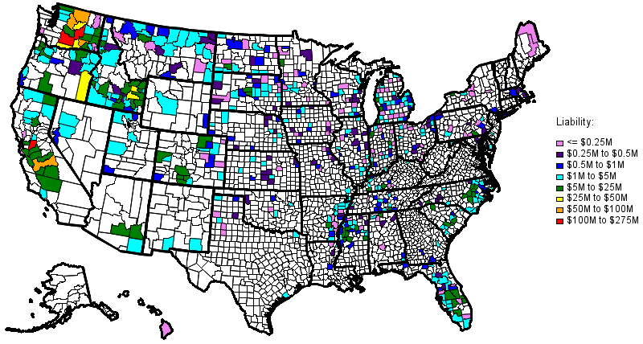
Whole Farm Revenue Protection
2018 Liability by County
*Data as of September 2018, subject to change

Slide 40
Whole Farm Revenue Protection
2018 Interesting Stats
Average of 4 crops per policy in 2018
Policies in 45 states and 590 counties
59 farms with 10 or greater crops
Most diverse farms:
  33 crops (Michigan)
  29 crops (Michigan)
  28 crops (Michigan)

Slide 41
NAP
Available through the Farm Service Agency not private insurance agents.
Covers crops not covered by insurance programs.
Does not cover all crops and no livestock.
Meant as disaster coverage.
  Covers losses greater than 50% of expected production based on approved yield and reported acreage.

Slide 42
Actual Production History
4-10 year actual yield history
T-yield based on 10-year county average
If < 4 years of actual records, insured receives variable T-yield based on years of actual history:
  No records, but has grown the crop, 65% of T-yield
  1 year of records and three 80% T-yields
  2 years of records and two 90% T-yields
  3 years of records and one 100% T-yield
New Producers receive 100% of the T-yield
Notes:
The APH component is an important part of a producer’s insurance program. As discussed earlier, APH is simply a way of averaging a producer’s yields over a 4-10 year time span. The APH average yield is then used to calculate the producer’s guarantee and determine the premium rate.
Every year that the producer is in the crop insurance program, he/she must report the actual production from the previous crop year. The production reporting deadline is the earlier of the acreage reporting date or 45 days after the sales closing/cancellation date. For example, a spring planted crop with a sales closing date of March 15 and an acreage reporting date of June 15 has a production reporting deadline of April 29 (45 days after the sales closing date).
If an insured does not have 4 years of actual records for a crop on a particular unit, variable transitional yields (T-yields) are used to complete the four year database, as shown above. T-yields are based on the county 10-year average as determined by the National Agricultural Statistical Service. The percentage of the T-yield applicable is determined based on the number of APH years with an actual yield. For instance, if no actual records are available, the four year database will contain four 65% T-yields. One year of actual records is combined with three 80% T-yields, two years of actual records are combined with two 90% T-yields, and three years of actual records are combined with one 100% T-yield. Once four or more years of actual yields are available, T-yields are not used. As more years of actual production history are reported, insurance yields more accurately reflect the individual insured’s capability of producing the crop.
“New Producer” is a term assigned to producers who have not produced the insured crop in the county for more than two years. These producers do not have the ability to provide four years of records, simply because they have not been farming the crop that long. These producers can receive 100% of the T-yield rather than a percentage of it.

Slide 43
Catastrophic Coverage (CAT)
Basic units only
50% coverage level
55% of maximum price selection
50/55 policy (used to be 50/60)
Cost – administrative fee $655 per crop per county, waived for limited resource farmers

Slide 44
CAT Example - Cotton
700 lb./acre APH Proven Yield
350 lb./acre trigger yield
$0.63 maximum price
$0.347 indemnity price ($0.63 x .55)
Coverage = 700 x .50 = 350 lb/ac
Protection = 350 lb. x $0.347 = $121.30
Very little yield and price coverage
100% x 50% x 55% = 27.5% coverage

Slide 45
Yield Protection (APH) Example
APH Yield = 3,000 lbs
Coverage Election = 70%
Production Guarantee = 3,000 lbs x 70% = 2,100 lbs
Insured Coverage Price Election = $0.22 per lb (100%)
Peanuts
Ex. 1 -- Actual Yield (Production To Count) = 2,400 lbs
Insured Loss = 0 lbs
Ex. 2 -- Actual Yield (Production To Count) = 1,900 lbs
Insured Loss = 2,100 lbs – 1,900 lbs = 200 lbs
Indemnity = 200 lbs x $0.22 per lb = $44 per acre

Slide 46
Yield Protection (APH) Example
APH Yield = 700 lbs
Coverage Election = 70%
Production Guarantee = 700 lbs x 70% = 490 lbs
Insured Coverage Price Election = $0.75 per lb (100%)
Cotton
Ex. 1 -- Actual Yield (Production To Count) = 490 lbs
Insured Loss = 0 lbs
Ex. 2 -- Actual Yield (Production To Count) = 400 lbs
Insured Loss = 490 lbs – 400 lbs = 90 lbs
Indemnity = 90 lbs x $0.75 per lb = $67.50 per acre

Slide 47
Revenue Protection Cotton Example
APH Yield = 700 lbs per acre
Coverage Level = 70% (490 lbs)
Projected Price (Base Price) = 0.75 cents per pound
Revenue Guarantee = APH Yield x Coverage Level x Projected Price
= 700 lbs x 70% x $0.75 = $367.50 per acre

Slide 48
Revenue Protection
Possible Price-Yield Combinations
Production Loss, Price Goes Up
May or May Not Get Indemnity Depending on Amount of Loss and Price
Production Loss, Price Goes Down
Will Get Indemnity
No Production Loss, Price Goes Up
Will Not Get Indemnity
No Production Loss, Price Goes Down
May or May Not Get Indemnity Depending on Price

Slide 49
Example: Production Loss, Price Goes Up
Projected Price = $0.75
Harvest Price = $0.85 (higher than Projected Price)
Revenue Guarantee = Production Guarantee x Higher of PP or HP
Guarantee = 700 lbs x 70% x $0.85 = $416.50
Actual Yield (Production To Count) = 450 pounds (40 lb yield loss)
Calculated Revenue (Crop Value) = Actual Yield x Harvest Price
Calculated Revenue = 450 pounds x $0.85 = $382.50 per acre
Indemnity = Revenue Guarantee - Calculated Revenue
Indemnity = $416.50 - $382.50 = $34 per acre
Would not have triggered a payment if used 75 cents → $367.50 Guarantee

Slide 50
Example: Production Loss, Price Goes Down
Projected Price = $0.75
Harvest Price = $0.65 (lower than Projected Price)
Revenue Guarantee = Production Guarantee x Higher of PP or HP
Guarantee = 700 lbs x 70% x $0.75 = $367.50
Actual Yield (Production To Count) = 450 pounds (40 lb yield loss)
Calculated Revenue (Crop Value) = Actual Yield x Harvest Price
Calculated Revenue = 450 pounds x $0.65 = $292.50 per acre
Indemnity = Revenue Guarantee - Calculated Revenue
Indemnity = $367.50 - $292.50 = $75 per acre

Slide 51
Example: No Production Loss, Price Goes Down
Harvest Price = $0.65 per pound
Revenue Guarantee = Production Guarantee x Higher of PP or HP
Guarantee = 700 lbs x 70% x 75 cents = $367.50
Actual Yield (Production To Count) = 700 pounds (no yield loss)*
Calculated Revenue (Crop Value) = Actual Yield x Harvest Price
Calculated Revenue = 700 pounds x 65 cents = $455 per acre
Indemnity = Revenue Guarantee - Calculated Revenue
Indemnity = $367.50 - $325 = $42.5 per acre
Payment did not trigger at 65 cents Harvest Price, would have to fall to 52 cents

Slide 52
Example: No Production Loss, Price Goes Up
Harvest Price = $1.00 per pound (less than Base Price)
Revenue Guarantee = Production Guarantee x Higher of PP or HP
Guarantee = 700 lbs x 70% x $1.00 = $700
Actual Yield (Production To Count) = 700 pounds (no yield loss)*
Calculated Revenue (Crop Value) = Actual Yield x Harvest Price
Calculated Revenue = 700 pounds x $1.00 cents = $700 per acre
Indemnity = Revenue Guarantee - Calculated Revenue
Indemnity = $700 - $700 = $0 per acre
No production loss and no payment due to higher harvest price on
Production to Count

Slide 53
How to Make Crop Insurance Work for You
Get off CAT- the first level of buy up gives you optional units, replant payments, 45% more coverage, maintains Emergency Loan eligibility, etc., for very little cost per acre
You MUST prove your yield
The 65-70% level provides the maximum dollar subsidy compared to your cost and is generally the best buy-all things considered.
The revenue-type products are attractive when prices are volatile.

Slide 54
Crop Insurance Prices
 | 2015 | 2016 | 2017 | 2018 | 2019 | 2020*
Corn | $3.68 | $3.81 | $3.87 | $3.82 | $3.97 | $3.93
Cotton | $0.63 | $0.62 | $0.73 | $0.75 | $0.74 | $0.70
Grain Sorghum | $3.64 | $3.75 | $3.81 | $3.78 | $3.95 | $3.76
Peanut, RU | $416.20 | $407.80 | $395.40 | $392.20 | $416.80 | $398.20
Peanut, VA | $482.80 | $493.40 | $438.80 | $443.00 | $441.80 | $434.00
Soybean | $8.66 | $8.91 | $10.25 | $10.09 | $9.65 | $9.40
0.7
3.93
3.76
0.1991
0.217
9.4
Source: USDA RMA Price Discovery (February 28 Closing Date) 2/6/20

Slide 55
General Information
New in 2018 Farm Bill
Enrollment on a crop-by-crop basis:
May pick and choose crops to enroll or not enroll
  Seed Cotton is eligible for STAX if it is not enrolled in ARCPLC
Less than 100% of base acres on the farm IS allowed
Partial enrollment of a crop’s base acres is NOT allowed
Notes:
The enrollment decision is either all or none for each crop.

Slide 56
Multi-Peril Crop Insurance for Hemp
Press release February 6 announcing pilot insurance program.
MPCI coverage against loss of yield because of insurable causes of loss for hemp grown for fiber, grain or Cannabidiol (CBD) oil.
NAP coverage protects against losses associated with lower yields, destroyed crops or prevented planting where no permanent federal crop insurance program is available.
Producers may apply now, and the deadline to sign up for both programs is March 16, 2020.

Slide 57
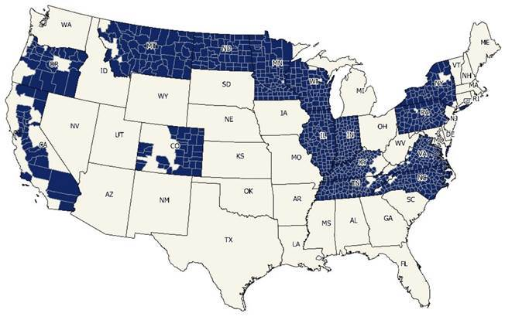
Hemp MPCI Pilot States and Counties

Slide 58
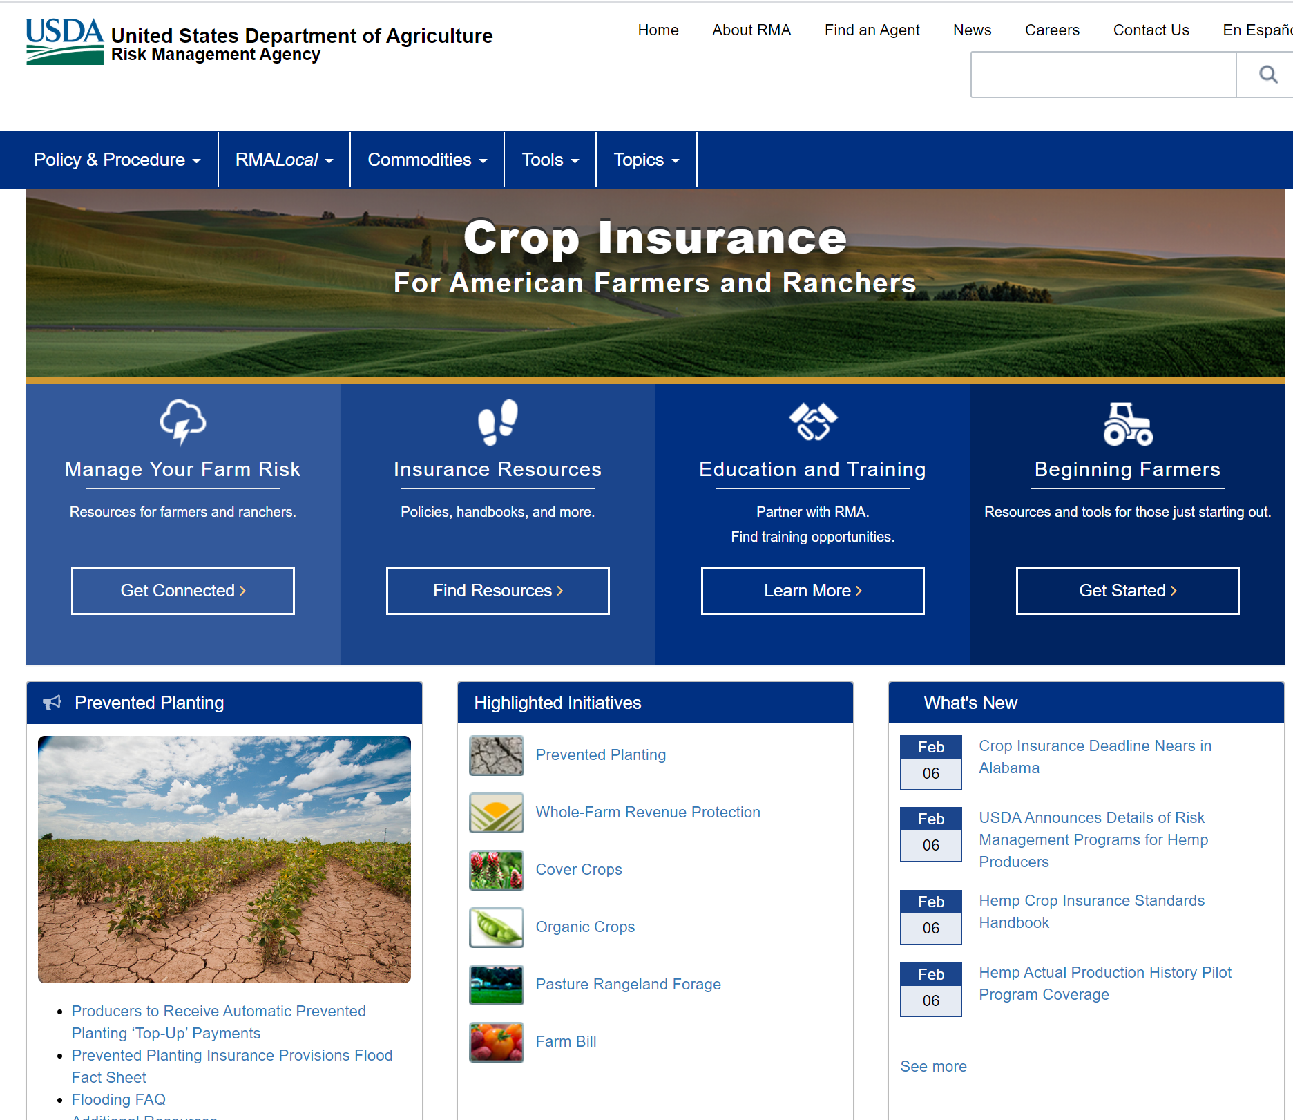
https://www.rma.usda.gov/

Slide 59

Thank You
Clemson University Extension Agribusiness Team
http://www.clemson.edu/extension/agribusiness
Nathan Smith, PhD.
Agribusiness Program Team Leader
Sandhill Research and Education Center
803-788-5700 (o)
229-392-3948 (m)
nathan5@clemson.edu

