Slide 1
Crisis Communications: Preparation is Key
Executive farm Management Program
Anissa Davenport, Managing Partner, Possibility Partners
February 4, 2025

Slide 2
What is Crisis Communications?
A crisis is a significant threat to operations that can have negative consequences if not handled properly, generally resulting in:
Financial loss
Reputation loss
Public safety
Source: InstituteforPR.org/crisismanagementandcommunications

Slide 3
The Media May Know Before You Do
Johnson & Johnson – Tylenol Crisis
Robert Andrews, J&J’s Assistant PR Director recalled how "We got a call from a Chicago news reporter. He told us that the medical examiner there had just given a press conference - people were dying from poisoned Tylenol. He wanted our comment. As it was the first knowledge we had here in this department, we told him we knew nothing about it. In that first call we learned more from the reporter than he did from us."
Johnson & Johnson Chairman James Burke swiftly formed a seven-member strategy team, guiding them to answer two questions: “How do we protect the people?” and “How do we save the product?”
-Skogrand PR Solutions Tylenol Case Study
-PR Week, October 2015

Slide 4
Are You Prepared for a Crisis?
Do you have an internal communication strategy?
Are you able to reach employees, customers, strategic partners with updates and changes?
Do you have dedicated team member to handle communications and/or operational risk?
Do you have a plan to manage when when employee turnover or when employees are out sick?

Slide 5
Are you ready for a crisis?
What is included in a crisis communication plan?
Mission, Vision, Values, Purpose
Objectives and Strategies
Roles and Responsibilities
Activation Plan
Resource Inventory
Templates and Tools to Get Started

Slide 6
What Makes a Crisis Communications Plan Successful?
1. Prevention and Planning
2. Agility and Responsiveness
3. Expertise/Resources
4. Messages that reinforce and align your company’s mission, vision, values and purpose
5. The Right Spokesperson(s)
6. Transparency and Accountability

Slide 7
Prevention & Planning
Do your employees know your company’s mission/purpose? Values?
How would you define your culture?
Would your employees report things they see?
Do they feel safe speaking up?
Do they feel a sense of ownership in your company?
What can go wrong?
How likely will it happen?
What damage can result?
Notes:
Conducting a Proactive Assessment will help you with your agility and quickness

Slide 8
Agility & Responsiveness
If you don’t tell your story, someone will tell it for you
24/7 real-time news cycle
Social Media – Facebook, Instagram, Twitter, Snap Chat, LinkedIn and more
Online news channels
Smart phones with cameras and videos
Apps

Slide 9
Expertise & Resources
Do you have the resources and expertise to handle this crisis/issue internally?
Do you need outside assistance? If so, do you know who to call?
Who in your company is the expert on the matter at hand?
Do you have your Mission, Vision and Values articulated? What is your brand promise?
Who in your organization has experience talking to the media?

Slide 10
Messaging that aligns and reinforces your mission, vision, values and brand
Mission/Purpose: why you exist
Vision: what you are striving to become
Values: behaviors that will guide you along the way
Brand: the sum of who you are and what you stand for

Slide 11
Set a clear company mission, vision and values. Start with your why.
Define and communicate stakeholder expectations
Who is responsible for the company’s reputation
It starts with leadership
It is everyone’s responsibility
As a leader, what can you do?
Messaging that aligns and reinforces your mission, vision, values and brand
Notes:
Stakeholders include: customers, regulatory bodies, partners, vendors, public, media

Slide 12
Choosing the Right Spokesperson
Ideally, someone who has been trained as a spokesperson or who has had media training.
Other questions to consider:
Is this person an expert on the matter?
Does this crisis require the head of the organization to respond or would it be better to have a subject-matter expert?
Can this person speak on behalf of our company?

Slide 13
Spokesperson Best Practices
Tell your company’s story in succinct sound bites
Make sure the spokesperson is fully briefed on your key messages and is aware of the latest developments
Avoid using the phrase “no comment”
Avoid using jargon that the public will not understand
Have strong eye contact
Avoid saying “uhms” and be aware of other nervous gestures

Slide 14
Transparency and Accountability
Tell the truth like your reputation depends on it, because it does.
Tell your story in a manner that is compelling and personal.
Take accountability at the top of the organization.
Notes:
Take responsibility for what went wrong
Be accurate and consistent
If you don’t tell your story, someone else is likely to do so (social media)
Important for employees and the public to see leadership

Slide 15
Preparing for an Unexpected Crisis
Take
Take a deep breath, step back and pause long enough to see the bigger picture and what is happening
Be
Be open to re-evaluating your plan when new info presents itself; praise the person who reports a mistake
Do
Do, monitor, diagnose, repeat
Avoid
Avoid silo-thinking: know something about everyone else’s job, understand how various tasks fit together and how they fit into the big picture
Notes:
When something unexpected goes wrong (Deepwater Horizon Oil Spill, Facebook IPO)

Slide 16
Workshop Part 1

Slide 17
Applying the Case Study
What crisis is the Brown Family facing?
How should they respond? Is not responding an option? Why or why not?
What questions could the media ask?
If they respond to the media, what should they include in their response? What should they NOT include?
What form of communication (spokesperson, statement, etc.) should they use?
What other concerns should they anticipate during a crisis?

Slide 18
Workshop Part 2

Slide 19
Apply the Case Study
How do you currently educate/communicate/create meaning around your company’s purpose/mission/vision/values/brand?
Risk assessment: How do you identify risks in your organization? What can go wrong? What keeps you up at night? List the top five areas of concern.
For each issue listed, determine how likely will it happen?
You may want to use a ranking system and have several key members score the likelihood. Ex: 1 - very unlikely, 2 - unlikely, 3 - possible, 4 - likely, 5 - very likely
For each issue, determine what damage could result.

Slide 20
Appendix

Slide 21
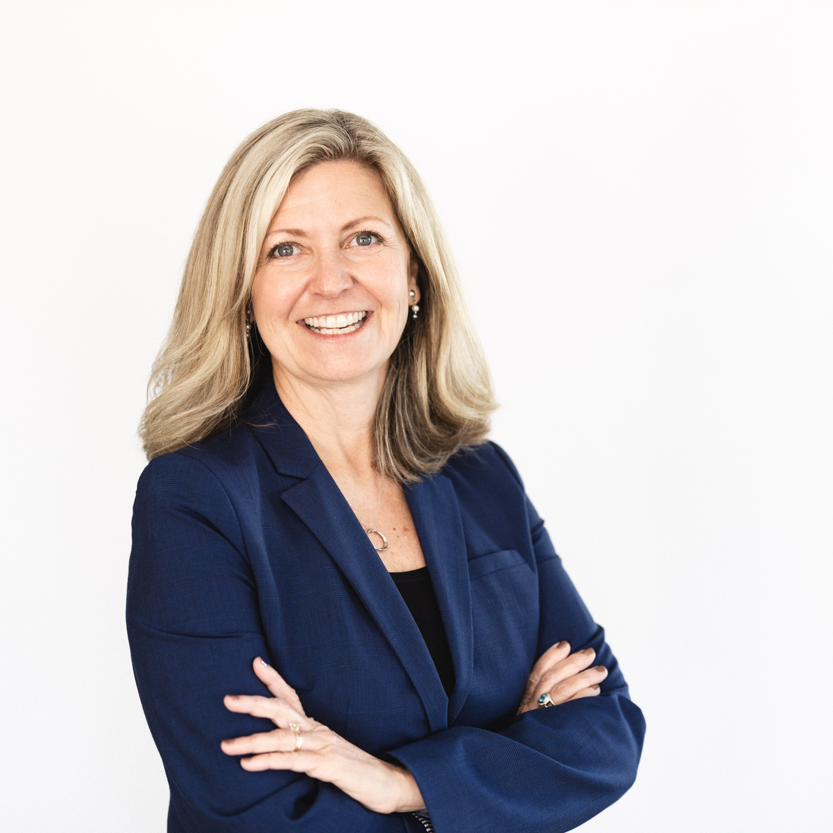
Anissa Davenport, Founder & Managing Partner Possibility Partners
Anissa has worked for more than 25 years in various business sectors focused on strategically growing businesses through branding, marketing, communications, innovation and customer experience. She has a unique ability to develop both strategic plans for growth, development and innovation while also focusing on pragmatic delivery of results and execution. She has a passion for coaching and developing others and maximizing the potential of organizations and is known for her contagious curiosity. As a coach and consultant, she has a passion for helping organizations and individuals unleash their potential and discover solutions that once seemed unreachable.
Roles:
Chief Strategic Development and Chief Marketing Officer for Vidant Health
President, Eye Integrated – marketing & web development firm
Account Executive, Royal Caribbean Cruise Lines, Hardee’s Food Systems
Industry experiences: Healthcare, Pharmaceuticals, Chemicals, Finance, Hospitality, Retail, Fast Food

Slide 22
Video Links

Slide 23
What Not To Do…..
https://www.youtube.com/watch?v=64647pQ7vsA

Slide 24
The Secret to Successful Crisis Management in the 21st Century - Melissa Agnes TEDx Talk
https://www.youtube.com/watch?v=VQGEPEaEWtg

